Slide 1

BCA (DATA SCIENCE) VI SEM GROUP PROJECT
DISASTER DETECTION SYSTEM
TEAM MEMBERS:
KARRI SUSANNA
Regd.no: 2021-2222021
P. CH. SRIVATHSA SARMA
Regd.no: 2021-2222028
KANDIPILLI TEJUS
Regd.no: 2021-2222033
ADIGARLA SARATH KUMAR
Regd.no: 2021-2222034
PAMPANA JAIKIRAN
Regd.no: 2021-2222043
Under Guidance of
Smt. U. Sahiti
Assistant Professor
Department of Computer Applications (UG)

Slide 2
CONTENTS
CONTENTS
01
04
ABSTRACT
PROPOSED SYSTEM
02
05
INTRODUCTION
PROCESS FLOW
03
06
EXISTING SYSTEM
CONCLUSION

Slide 3

ABSTRACT
ABSTRACT
The "Disaster Detection System" incorporates a crucial image processing process that utilizes advanced machine learning techniques to categorize images, identifying various types of disasters. This component stands at the forefront of disaster monitoring. By improving accuracy and responsiveness in identifying disasters, it aims to provide authorities and organizations with more accurate information.

Slide 4
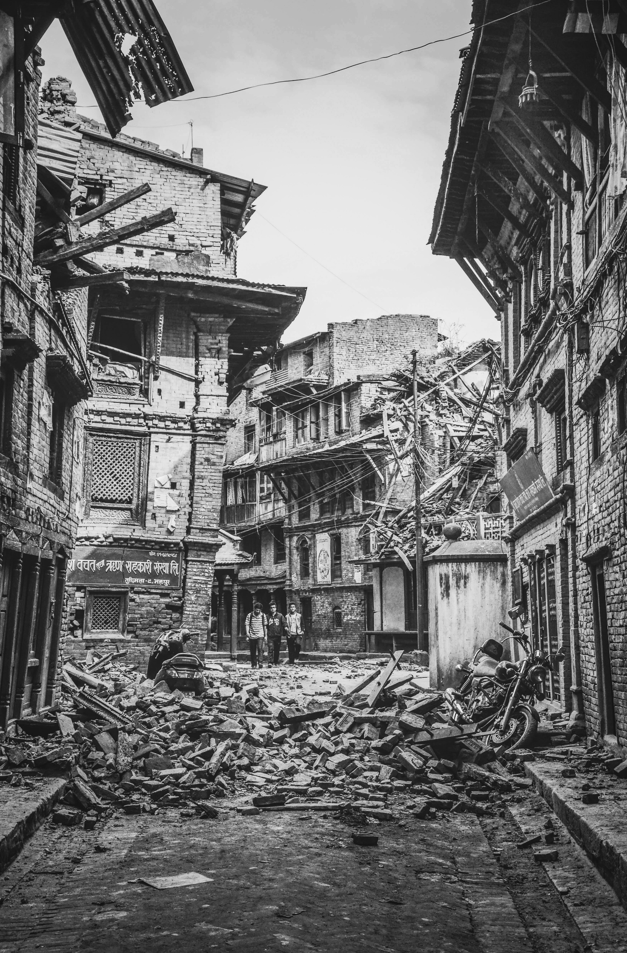
INTRODUCTION
INTRODUCTION
The "Disaster Detection System" project is a comprehensive initiative focused on advancing disaster monitoring and response capabilities.
It’s key component is image detection.
The image detection component utilizes advanced techniques and machine learning to categorize images, enabling the recognition of specific disaster types.
The integration of these components aims to offer a holistic solution, enhancing accuracy and responsiveness in disaster identification for effective interventions by authorities and organizations.

Slide 5
INTRODUCTION
INTRODUCTION
The project employs Python, Pandas, Scikit-learn, NLTK, and Keras for comprehensive data handling, machine learning, and deep learning capabilities.
Model persistence is achieved through Pickle, facilitating efficient storage and retrieval of trained models.
Tkinter is utilized to develop a user-friendly GUI, enabling interactive access to the disaster detection system.
The improvement of the existing system involves Random Forest to CNN for image recognition, enhancing overall system accuracy and efficiency.

Slide 6
EXISTING SYSTEM
EXISTING SYSTEM
A Random Forest model is employed for image recognition in the disaster detection system.
The Random Forest model categorizes images into distinct disaster types, enhancing visual content analysis.

Slide 7

RANDOM FOREST MODEL
RANDOM FOREST MODEL
Random Forest is a commonly used supervised learning algorithm, well-suited for classification tasks.
In the Disaster Detection project, it serves as the primary model for image detection, classifying images into specific disaster types based on extracted features.
Prone to overfitting, especially when using an abundance of decision trees, which can impact generalization on unseen data.
Can be computationally intensive, particularly with a large number of trees, potentially affecting efficiency in real-time applications.
Lack of interpretability: The ensemble nature of Random Forests may make it challenging to interpret and understand the decision-making process.
Limited performance with high-dimensional, sparse data, which may impact its effectiveness in certain image detection scenarios.

Slide 8
PROPOSED SYSTEM
PROPOSED SYSTEM
The custom CNN model, developed with the Keras functional API, brings flexibility and excels in image-related tasks, offering a more intricate analysis of hierarchical features. This contributes to higher accuracy in recognizing disaster scenarios.
CNN models contribute to a comprehensive approach, addressing challenges in different data types—text and images—commonly encountered in disaster detection scenarios.
The adoption of these advanced neural network models reflects the system's commitment to staying at the forefront of machine learning techniques, ensuring a robust and adaptable framework for accurate disaster detection.
CNN models represents a holistic strategy, leveraging their strengths to enhance overall efficiency and accuracy in disaster detection.

Slide 9
CNN MODEL
CNNMODEL
Convolutional Neural Networks (CNNs) are pivotal in the Disaster Detection project's image detection component, specializing in image-related tasks.
The primary function of CNNs is to classify images into distinct disaster types by automatically learning hierarchical features.
CNNs excel in discerning intricate patterns, enhancing accuracy in identifying specific disaster scenarios based on extracted features.
CNNs address overfitting concerns through techniques like dropout and pooling layers, mitigating issues related to an abundance of decision trees in Random Forests.
Designed for efficiency in processing image data, CNNs are less computationally intensive than Random Forests with numerous decision trees, making them suitable for real-time applications.
CNNs offer improved interpretability compared to the ensemble nature of Random Forests, providing a more intuitive understanding of learned features with their layered architecture.
Excelling in handling high-dimensional image data, CNNs overcome limitations associated with high-dimensional, sparse data in certain image detection scenarios, where Random Forests may struggle.

Slide 10
PROCESS FLOW
The Disaster Detection System swiftly identifies and responds to emergencies in social media data, aiding disaster management and response teams.
TF-IDF, an essential component, assigns numerical weights to capture the essence of each message, considering both term frequency and significance.
Image preprocessing is vital for the image component of the Disaster Detection System, ensuring standardized input formats, stable model training, and enhanced robustness through consistent normalization and resizing operations.

Slide 11
IMAGE PREPROCESSING
load_img(file_path, target_size=(224, 224)):
Part of Keras preprocessing module (from keras.preprocessing.image import load_img).
Loads an image from file_path, resizing it to target_size (commonly set to (224, 224) for models like those in ImageNet competition).
img_to_array(img) / 255.0:
Converts the image to a NumPy array.
Divides by 255.0 for pixel value normalization to [0, 1], crucial for stabilizing learning and maintaining consistent numerical range.
Return Statement:
Returns the processed image as a NumPy array.
Prints an error message and returns None if any exception occurs during preprocessing (e.g., image loading issues).

Slide 12
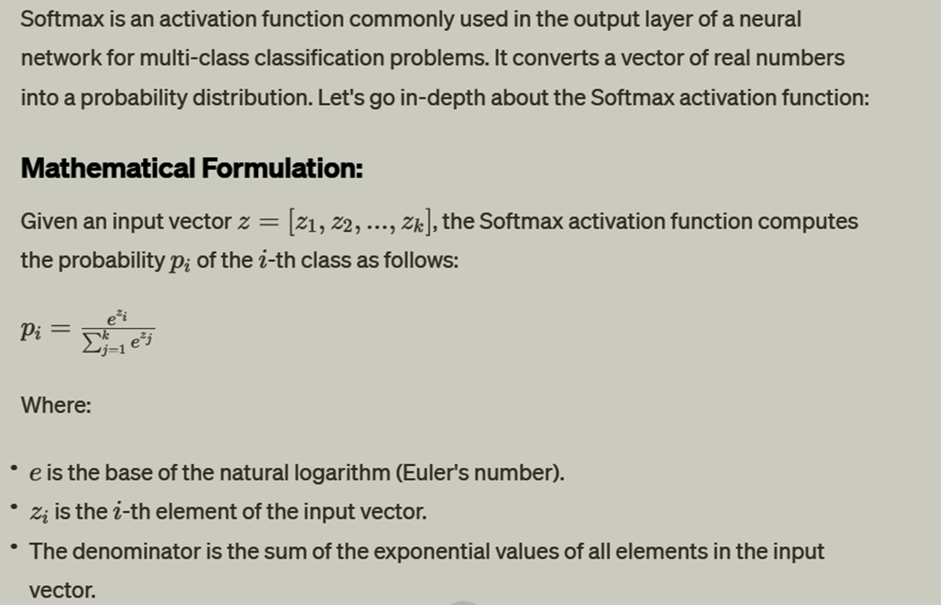
SOFTMAX

Slide 13
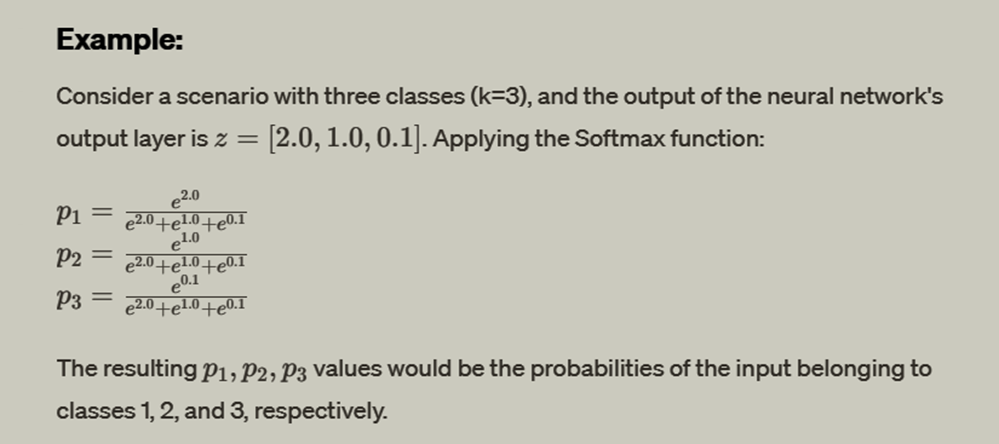
SOFTMAX

Slide 14
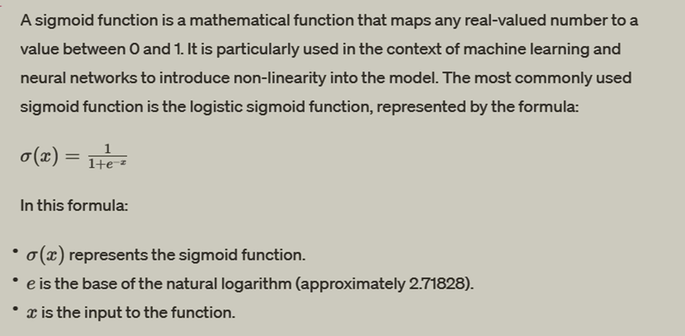
SIGMOID

Slide 15
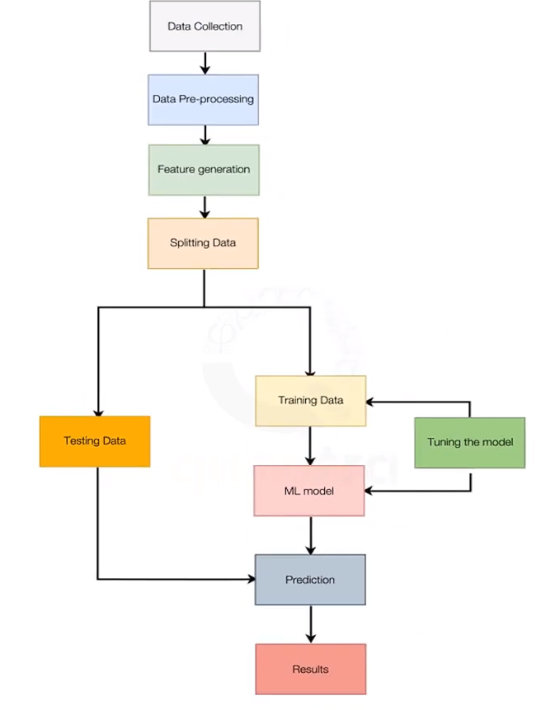
GENERAL PROCESS FLOW

Slide 16
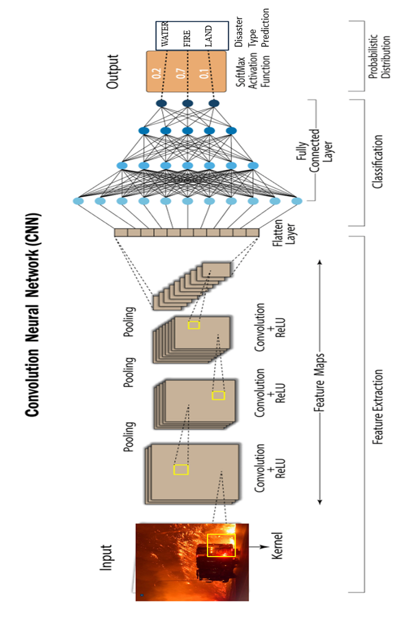
CNN PROCESS FLOW

Slide 17

CONCLUSION
In conclusion, the Disaster Detection project represents a significant advancement in leveraging state-of-the-art technologies for effective monitoring and response to calamities. Through the integration of advanced models such as Convolutional Neural Networks (CNNs) categorizing images. The project's success lies in its adaptability to handle complex data patterns, overcome model drawbacks, and provide a comprehensive solution for disaster detection.

Slide 18

THANK YOU!

